Slide 1
AWS VPC

Slide 2
WHAT IS VPC?
Amazon Virtual Private Cloud (Amazon VPC) lets you provision a logically isolated section of the AWS Cloud where you can launch AWS resources in a virtual network that you define.

Slide 3
WHAT CAN YOU DO WITH A VPC?
You have complete control over your virtual networking environment, including selection of your own IP address range, creation of subnets, and configuration of route tables and network gateways. You can use both IPv4 and IPv6 in your VPC for secure and easy access to resources and applications.

Slide 4
AN EXAMPLE?
For example, you can create a public-facing subnet for your web servers that has access to the Internet, and place your backend systems such as databases or application servers in a private-facing subnet with no Internet access. You can leverage multiple layers of security, including security groups and network access control lists, to help control access to Amazon EC2 instances in each subnet.

Slide 5
FEATURES OF A VPC? WHY VPC?
Secure : In addition, you can store data in Amazon S3 and restrict access so that it’s only accessible from instances in your VPC.
Simple : You can create a VPC quickly and easily using the AWS Management Console. You can select one of the common network setups that best match your needs and press "Start VPC Wizard."
Utilize all the scalability and reliability of AWS : You can instantly scale your resources up or down, select Amazon EC2 instances types and sizes that are right for your applications, and pay only for the resources you use

Slide 6
AWS ALLOWS SPECIFIC CIDR RANGES
Classless Inter-Domain Routing is a method for allocating IP addresses and IP routing.
10.0.0.0 – 10.255.255.255 (/8 prefix)
172.16.0.0 – 172.31.255.255 (/12 prefix)
192.168.0.0 – 192.168.255.255 (/16 prefix)

Slide 7
SOME USE CASES
HOST A SIMPLE, PUBLIC-FACING WEBSITE
You can host a basic web application, such as a blog or simple website in a VPC, and gain the additional layers of privacy and security afforded by Amazon VPC. You can help secure the website by creating security group rules which allow the webserver to respond to inbound HTTP and SSL requests from the Internet while simultaneously prohibiting the webserver from initiating outbound connections to the Internet. You can create a VPC that supports this use case by selecting "VPC with a Single Public Subnet Only" from the Amazon VPC console wizard.

Slide 8
SOME USE CASES CONTD…
HOST MULTI-TIER WEB APPLICATIONS
You can use Amazon VPC to host multi-tier web applications and strictly enforce access and security restrictions between your webservers, application servers, and databases. You can launch webservers in a publicly accessible subnet and application servers and databases in non-publically accessible subnets. The application servers and databases can’t be directly accessed from the Internet, but they can still access the Internet via a NAT gateway to download patches, for example. You can control access between the servers and subnets using inbound and outbound packet filtering provided by network access control lists and security groups. To create a VPC that supports this use case, you can select "VPC with Public and Private Subnets" in the Amazon VPC console wizard.

Slide 9
VPC DEMO
For this demo we will be doing the following.
Create a VPC from scratch.
Add two subnets to the VPC.
Attach an internet gateway to one subnet making it as the public subnet.
Configuring the route table.
Adding EC2 instances to the public and private subnets.
Adding and configuring a NAT Gateway as jump-machines for private subnet instances to have access to the internet.

Slide 10
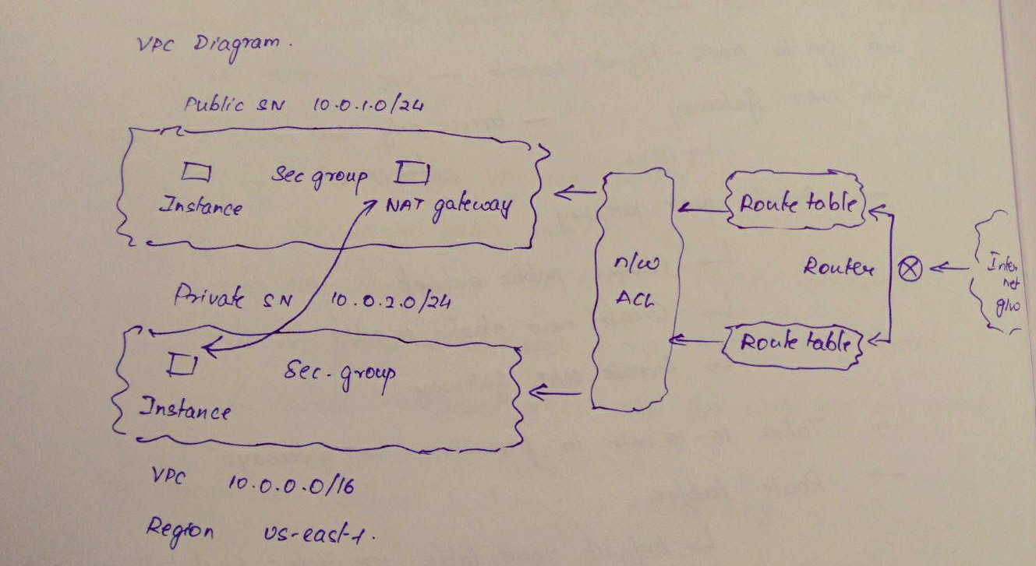
VPC DEMO DIAGRAM

